Slide 1
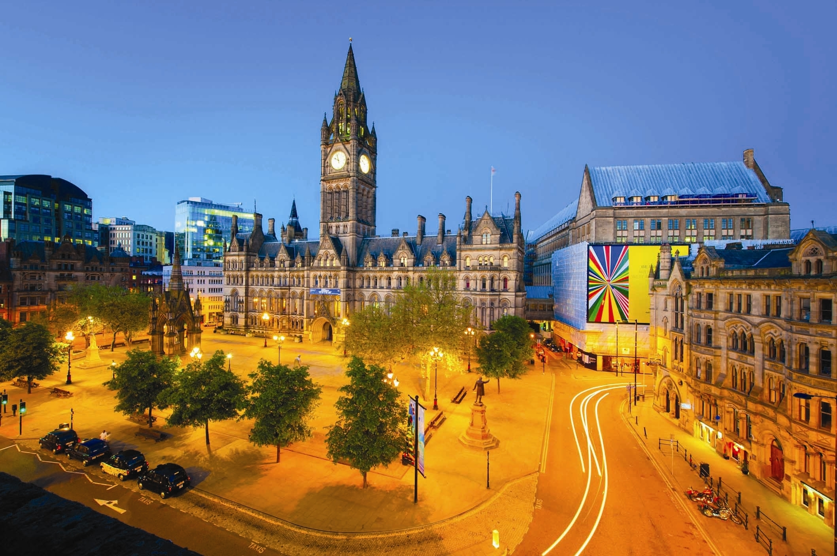
Discovering Manchester IBM Capstone Project - Exploring the best areas for a young professional to move to in Greater Manchester

Slide 2
Project Goals
Find number of venues using Foursquare API in each ward of Greater Manchester
Find proportion of green space in each ward of Greater Manchester
Apply clustering algorithms to characterise and classify wards
Make recommendation for ideal ward(s) for a young professional seeking move to Manchester
Preferred amenities: restaurants, bars and if possible, green space

Slide 3
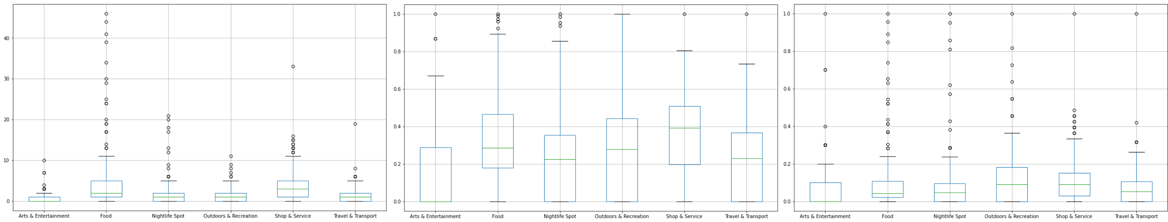
Features
Venue Count by Categories:
Food
Nightlife
Outdoors & Recreation
Shop & Service
Travel & Transport
Green space (percentage of total ward area)
Notes:
Mention how the data is ordered. i.e. venue count is discrete, zero-inflated and up to around 40 for some categories. (see choropleth on next slide)
Green space is a decimal value between (0-1).
Data must be scaled to be of the same magnitude.
Two sets of features: log transformed count data (reduce outliers impact) and non-transformed (keep shape). (Box plots show idea of data shapes)

Slide 4
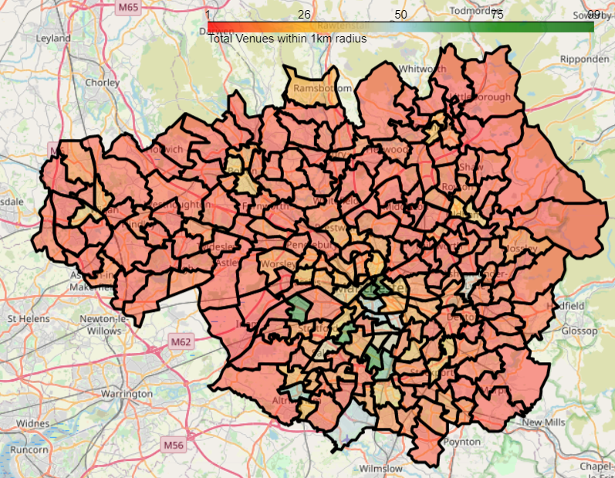
Notes:
Total venues within 1km of ward centres

Slide 5
Methods
K Means
Elbow Method and Silhouette Analysis
Spatially Constrained Hierarchical Agglomerative Clustering
Spatial Matrix - Enforces ‘spatial coherence’
Dendrograms – Can drill down into clusters or zoom out for deeper understanding of relationships
Notes:
Note: spatial matrix is fairly loose (4.6km) queens is too restrictive

Slide 6
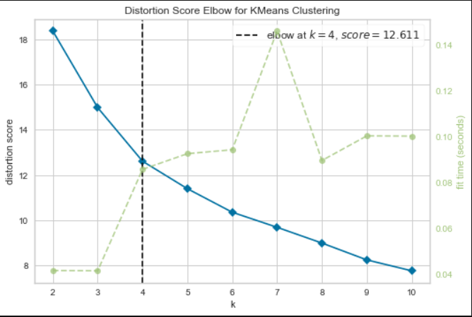
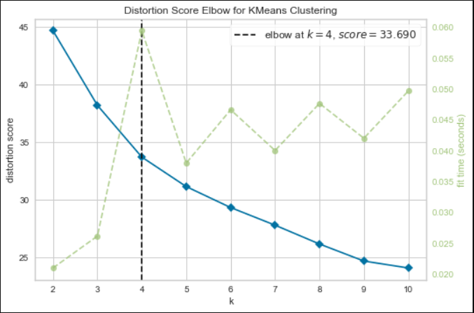
Elbow Method
Notes:
Produced using Yellowbrick package.
K = 4 suggested as this is the point with maximum curvature
Curve exhibits no clear ‘elbow’ – no clearly favoured value for k
Maybe silhouette will help?

Slide 7
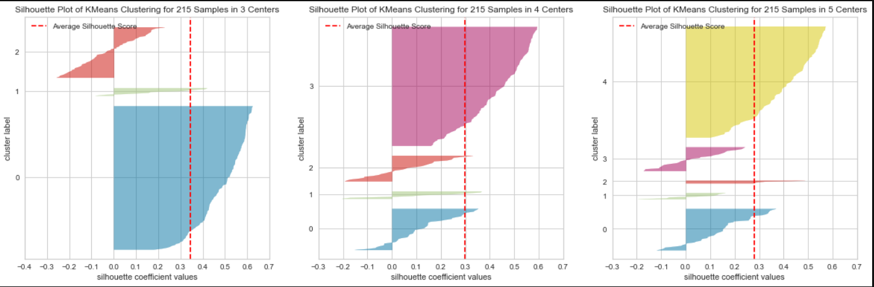
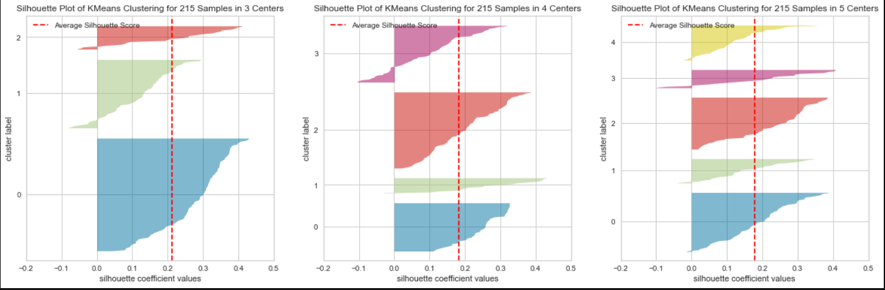
Notes:
Top: untransformed, Bottom: log transformed
What do we want from ideal k (i.e. high mean coefficient value, similar widths and heights, low number of outliers)
My Subjective choice? Untransformed 4 – transformed 5

Slide 8
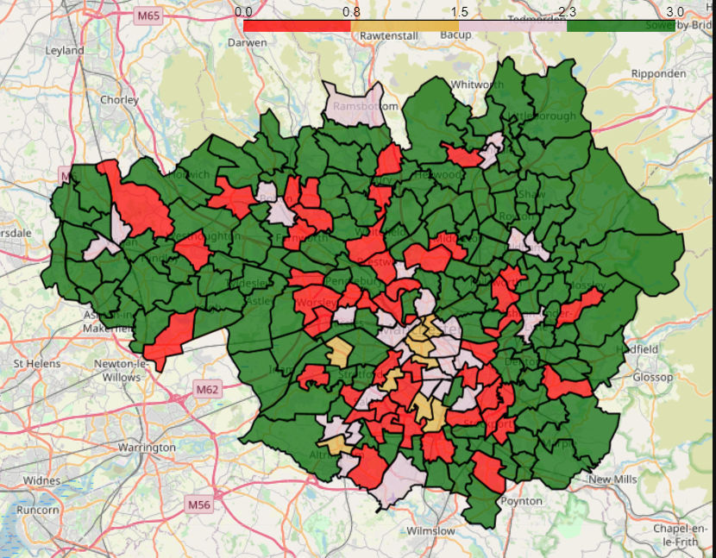
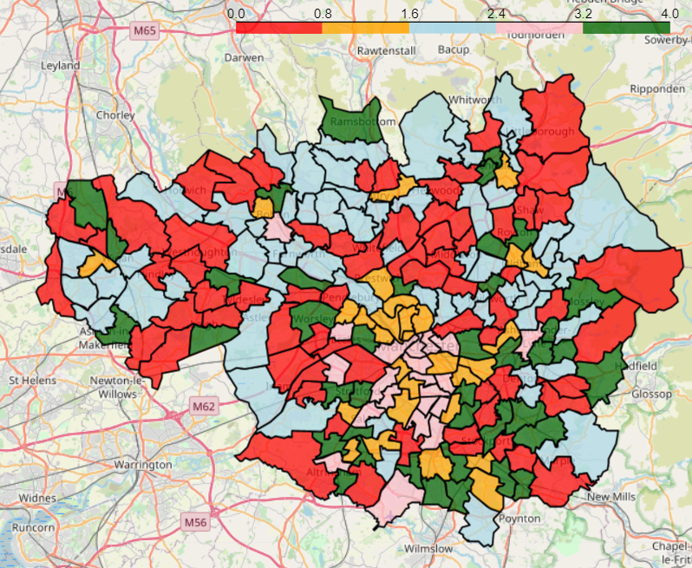
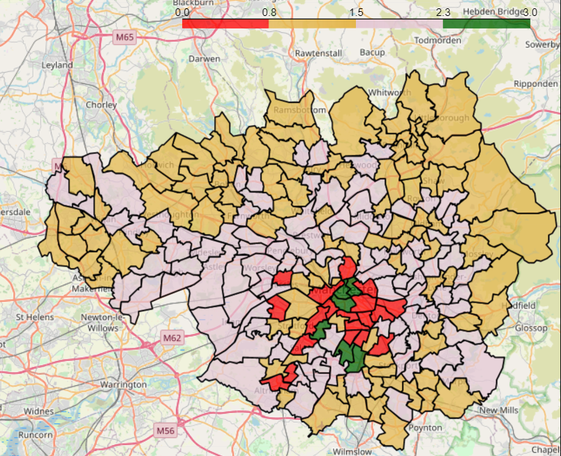
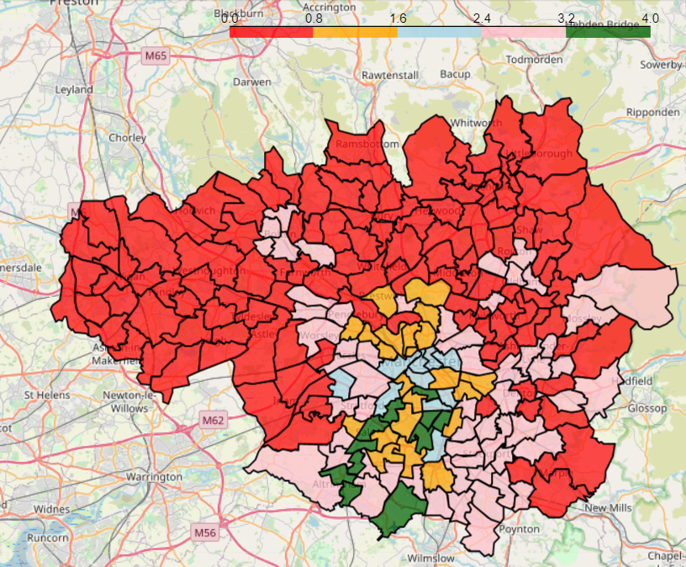
Notes:
Top left : K Means with 4 clusters on un transformed data; Top right: K Means with 5 clusters on log transformed data; Bottom left: Agglomerative Clustering with 4 clusters on un transformed data; Bottom right: : Agglomerative Clustering with 4 clusters on log transformed data;
Talk about ‘regions’ forming on bottom map
Highlight key wards being grouped together often
Bottom left is my preferred solution note green cluster of 6 (see means on slide 10)

Slide 9
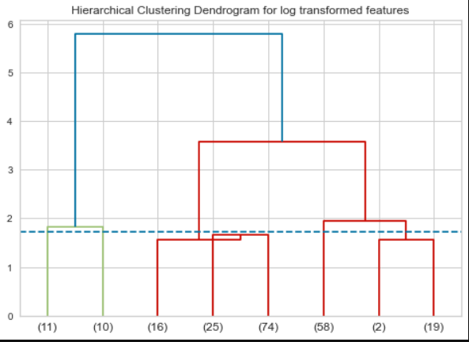
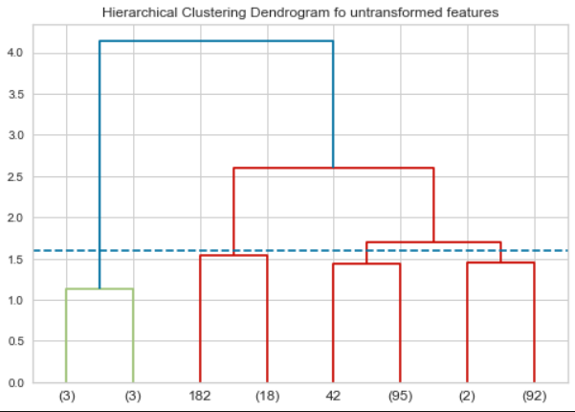
Dendrograms
Notes:
left: Agglomerative Clustering with 4 clusters on un transformed data; right: : Agglomerative Clustering with 4 clusters on log transformed data;
Note – our cluster of 6 from before is on the left, we can see that on expansion to 8 clusters this would split into 2 sub-clusters – doesn’t join the ‘rest’ even if we reduce to 2 cluster

Slide 10
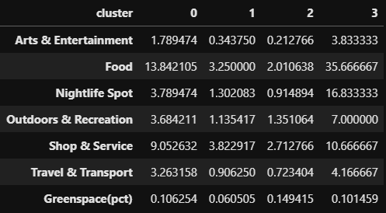
HAC of Non-Transformed Features Cluster Means
Notes:
Cluster 3 is prefered

Slide 11
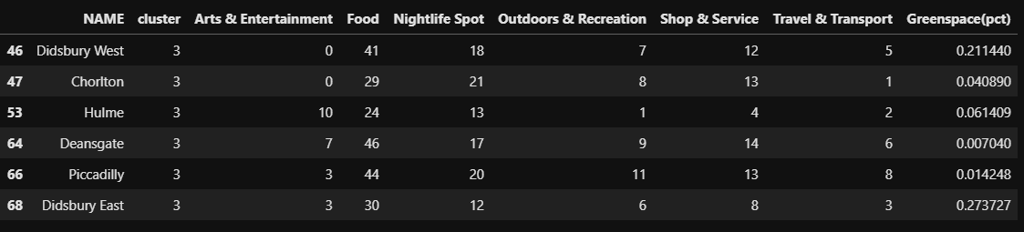
Cluster 3 - HAC of Non-Transformed Features
Notes:
Note high green space on Dids West and East

Slide 12
Conclusions
Limitations to results
Lumping counts and measurements into irregularly shaped wards
Lack of features
Foursquare 100 search limit
Didsbury West and East appear suitable wards

